Slide 1

Saxo Service Blueprint: Present and Future
Jinhong Brejnholt
Enterprise Foundation

Slide 2


Agenda
1. Introduction
2. Status
3. Roadmap
4. Q&A

Slide 3


What doesn’t work
Production Environment

Slide 4
What doesn’t work
Production Environment

Slide 5

What doesn’t work
Complex and Inconsistent Process
Drift-Prone
Manual and Slow
Poor feedback
Difficult Disaster Recovery

Slide 6
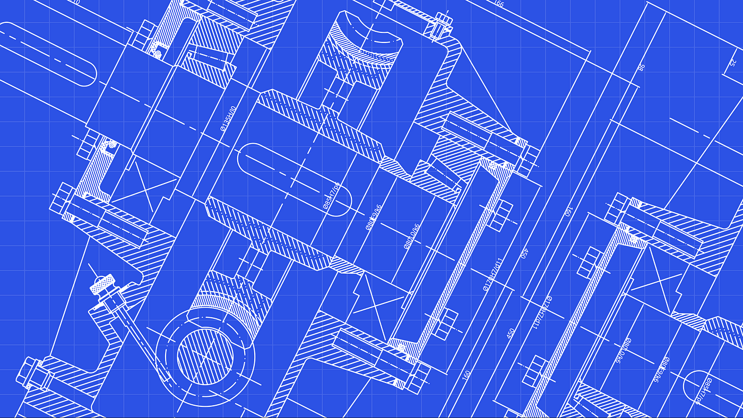

Saxo Service Blueprint
Notes:
Iac -> GitOps

Slide 7




Saxo Service Blueprint
Service

Slide 8
What doesn’t work
Complex and Inconsistent Process
Drift-Prone
Manual and Slow
Poor feedback
Difficult Disaster Recovery

Slide 9
What doesn’t work
Complex and Inconsistent Process
Drift-Prone
Manual and Slow
Poor feedback
Difficult Disaster Recovery

Slide 10
What doesn’t work
Simple and Consistent Target – Git
Drift-Prone
Manual and Slow
Poor feedback
Difficult Disaster Recovery

Slide 11
What doesn’t work
Simple and Consistent Target – Git
Constant Reconcile
Manual and Slow
Poor feedback
Difficult Disaster Recovery

Slide 12
What doesn’t work
Simple and Consistent Target – Git
Constant Reconcile
Automatic and Fast
Poor feedback
Difficult Disaster Recovery

Slide 13
What doesn’t work
Simple and Consistent Target – Git
Constant Reconcile
Automatic and Fast
Status visible at DevReach and Kubernetes
Difficult Disaster Recovery

Slide 14
What doesn’t work
Simple and Consistent Target – Git
Constant Reconcile
Automatic and Fast
Status visible at DevReach and Kubernetes
Built-in Disaster Recovery

Slide 15

What may work ☺
Simple and Consistent Target – Git
Constant Reconcile
Automatic and Fast
Status visible at DevReach and Kubernetes
Built-in Disaster Recovery

Slide 16
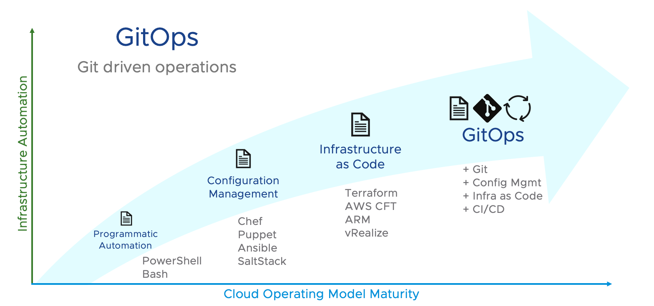

Slide 17
Plan
/
Azure Identity Role Assignment
Azure Managed Identity Provision
Azure SQL Access Provision
Kafka Topic Access Provision
Kubernetes Namespace Provision
Window Service AD Group Provision
VM Provision
Firewall Rule Updating
…
TLS Certificate Generation & Renewal

Slide 18
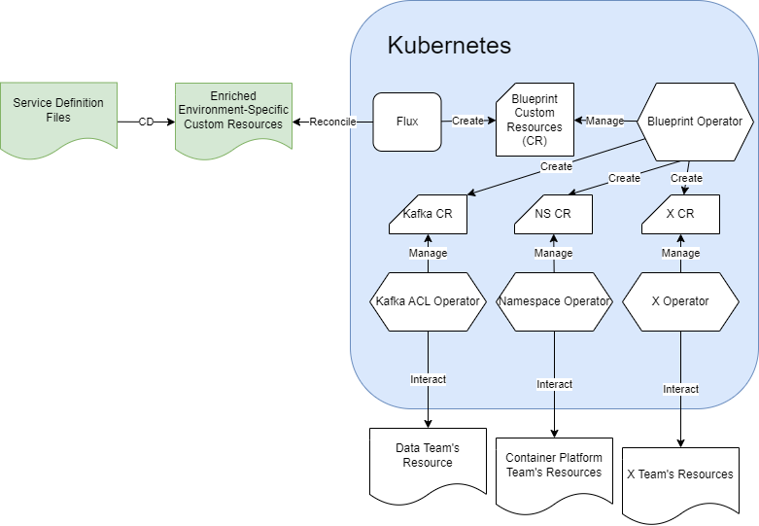
Saxo Blueprint Operators
Service

Slide 19
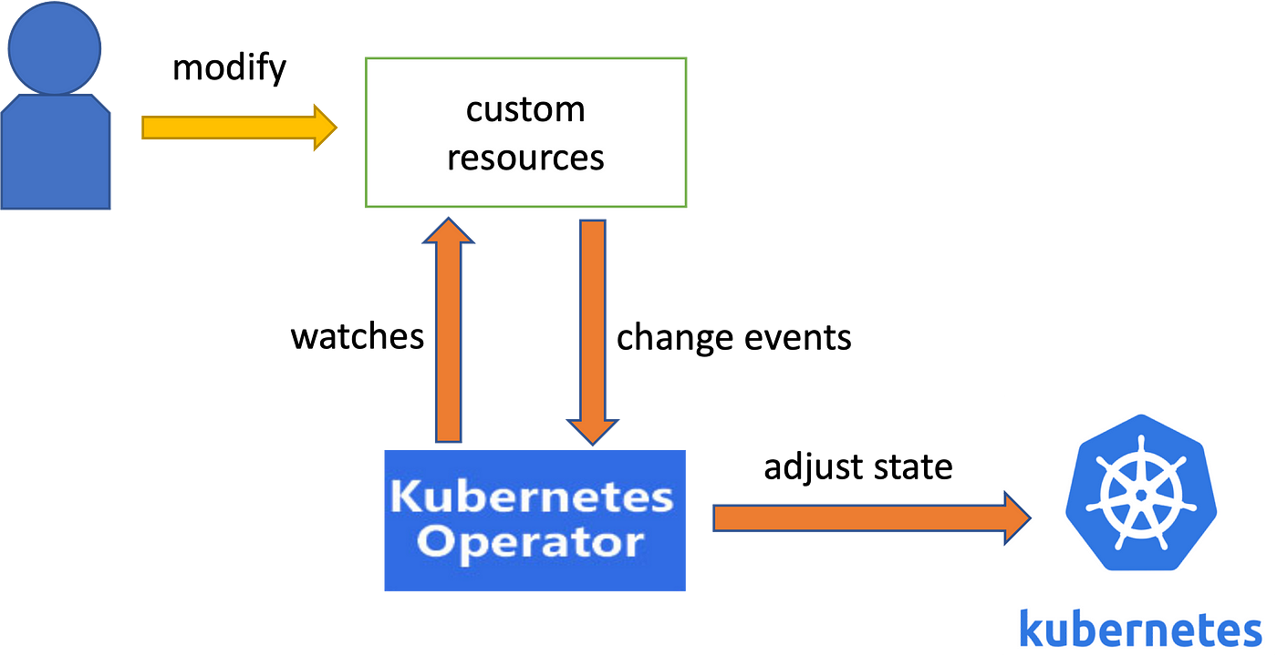
Operator Pattern
Notes:
Kubernetes has an ace up its sleeve that makes it even more useful, powerful, and flexible. That ace is called an Operator. Operators exist because Kubernetes was designed from the beginning for automation, which is built directly into the very heart of the software. In fact, Kubernetes allows users to automate the deployment and execution of workloads, and also the way that Kubernetes does these things.
This is why Operators are so powerful: they enable complex clusters and systems to operate automatically based on a set of patterns and principles. In short, Operators are patterns that extend the behavior of the cluster without changing the Kubernetes code. Its APIs act as custom resource controllers.
To understand the purpose of an Operator, we must first understand what it is. Then, we can understand how Kubernetes works and why Operators are so useful.

Slide 20

Enterprise Foundation Engineering

Slide 21





Enterprise Foundation Engineering
Oskar Kristiansen
Software Engineer
Travelling, boxing, cooking
Kristian Jensen
Senior Software Engineer
Fishing, nature, family
Jimmi Hested
Head of EFE
Football, family, technology
Ankur Singh
Senior Software Engineer
Cycling, travelling, driving
Lukas Schilling
Student Assistant
Math, competitive programming

Slide 22
Status
Azure Identity Role Assignment
Azure Managed Identity Provision
Azure SQL Access Provision
Kafka Topic Access Provision
Kubernetes Namespace Provision
Window Service AD Group Provision
DNS
Kibana Namespace Provision
…
TLS Certificate Generation & Renewal

Slide 24

Q & A

